Slide 1
CS 305 MICROPROCESSORS & MICROCONTROLLERS
MODULE 1

Slide 2
SYLLABUS
Evolution of Microprocessors
8086 Microprocessor
Architecture and signals
Memory organization
Minimum and maximum mode of operation
Minimum mode timing diagram
Comparison of 8086 and 8088

Slide 3
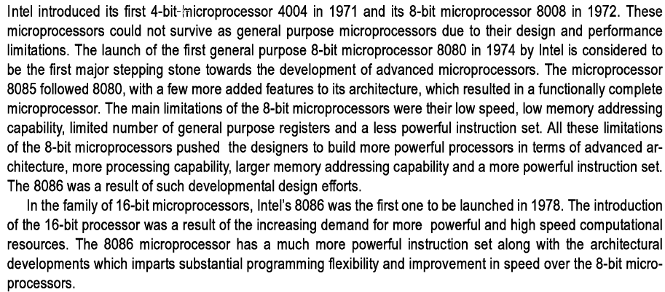
EVOLUTION OF MICROPROCESSORS

Slide 4
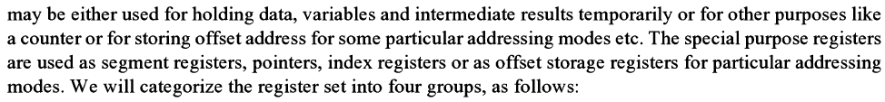
8086 Microprocessor

Slide 5
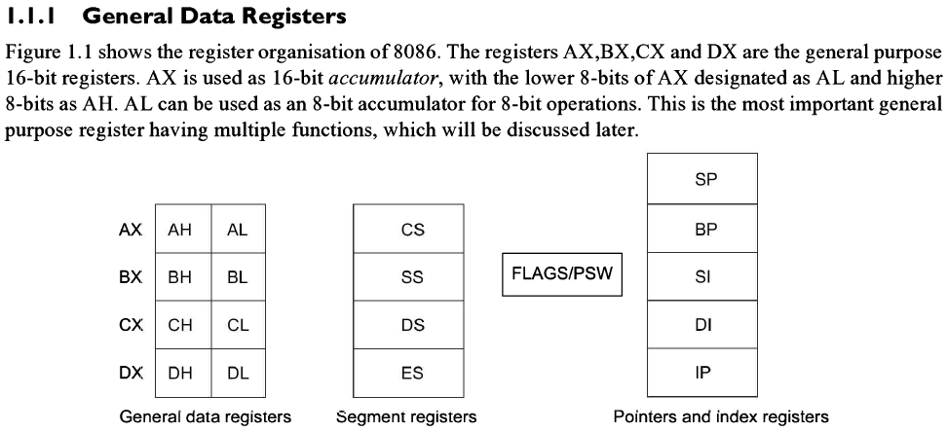
8086 Microprocessor (CONTD)

Slide 6
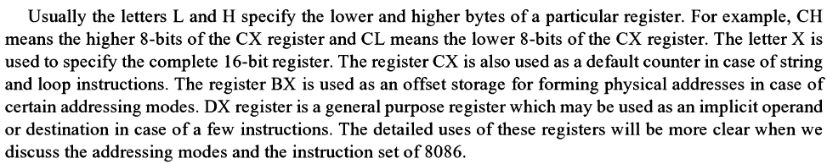
8086 Microprocessor (CONTD)

Slide 7
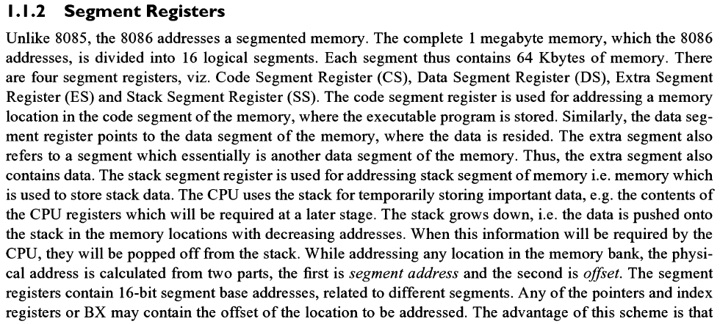
8086 Microprocessor (CONTD)

Slide 8
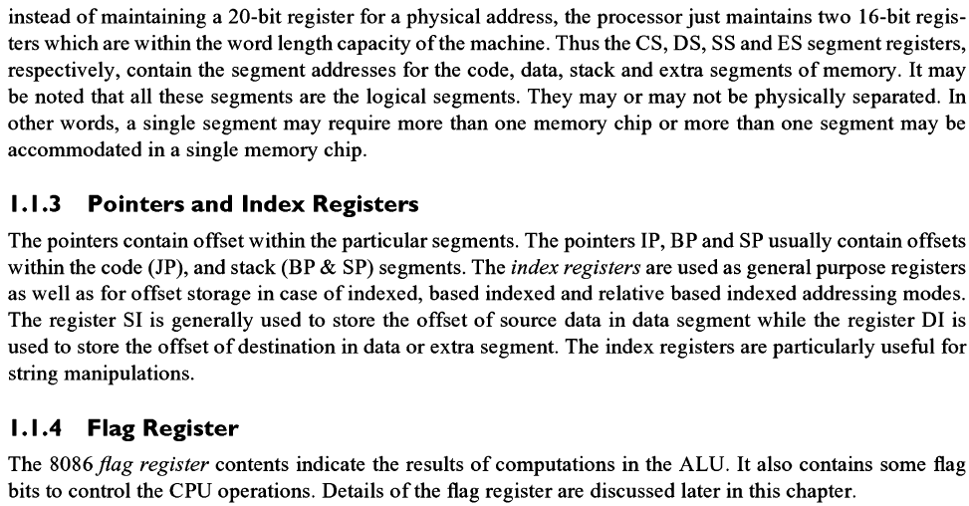
8086 Microprocessor (CONTD)

Slide 9
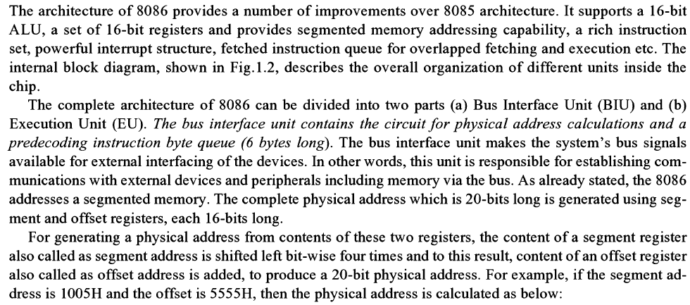
ARCHITECTURE

Slide 10
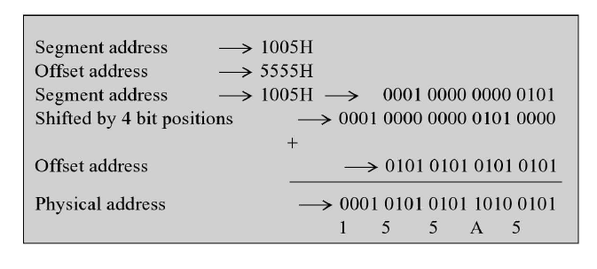
PHYSICAL ADDRESS CALCULATION

Slide 11
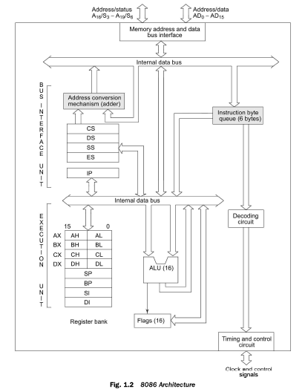

Slide 12

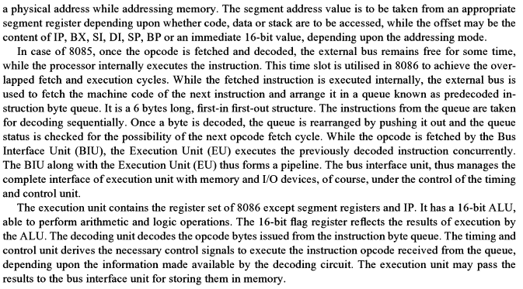

Slide 13
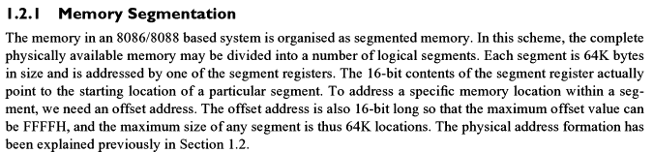
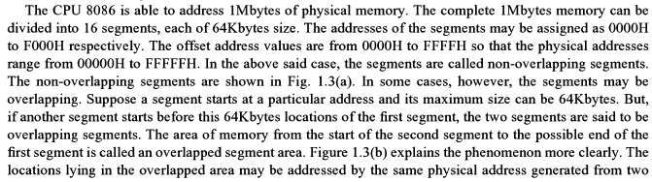
MEMORY ORGANISATION

Slide 14
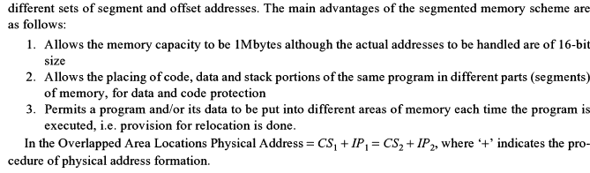
MEMORY ORGANISATION (contd)

Slide 15
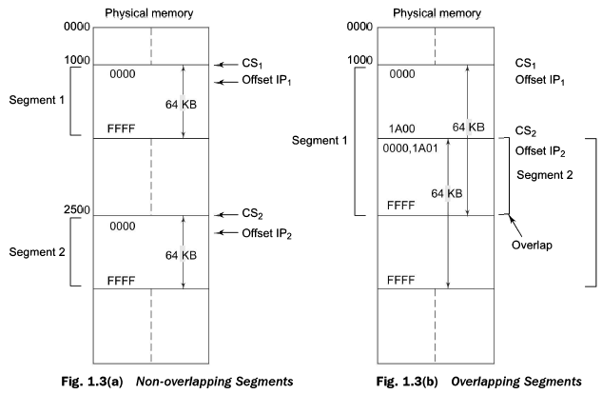
SEGMENTED MEMORY

Slide 16
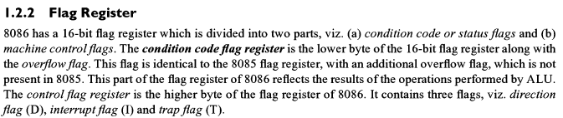
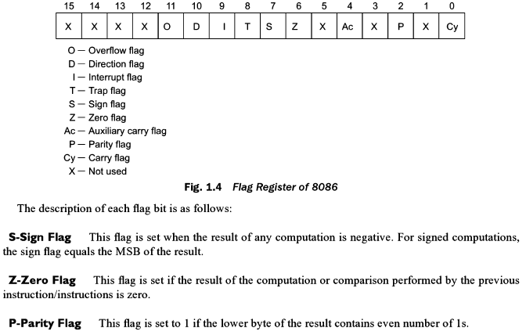

Slide 17
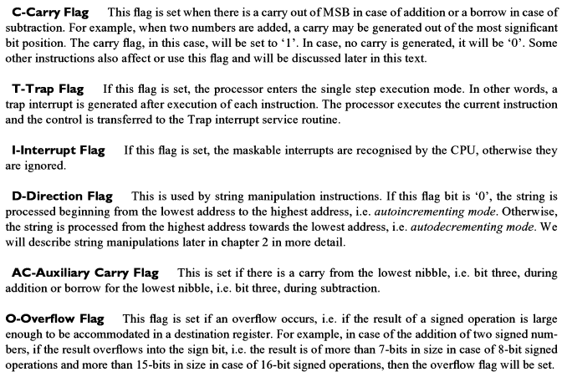
FLAG REGISTERS

Slide 18
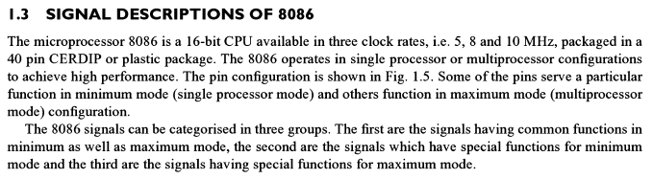
SIGNAL DESCRIPTION

Slide 19
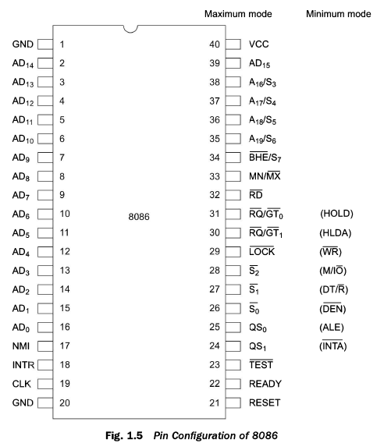

Slide 20

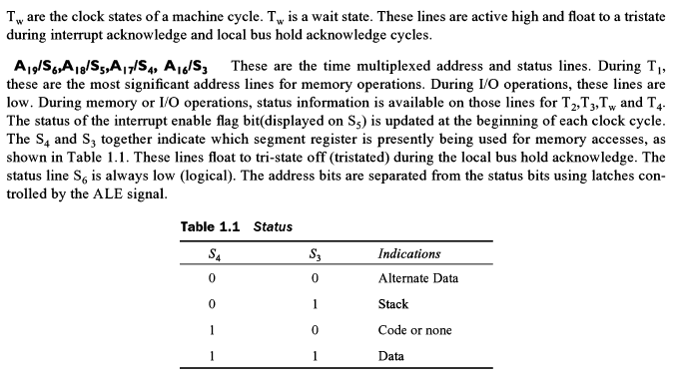
SIGNAL DESCRIPTION (CONTD)

Slide 21
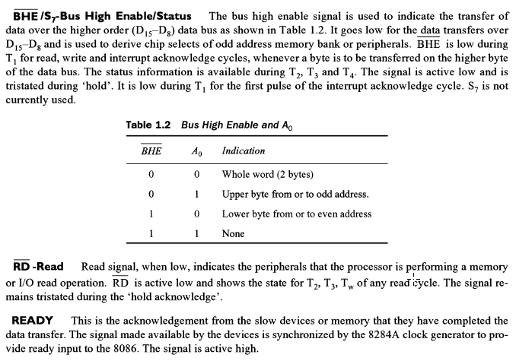
SIGNAL DESCRIPTION (CONTD)

Slide 22
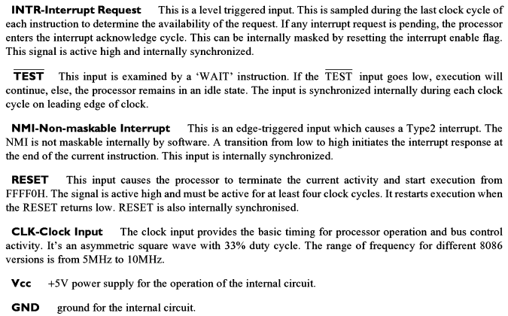
SIGNAL DESCRIPTION (CONTD)

Slide 23
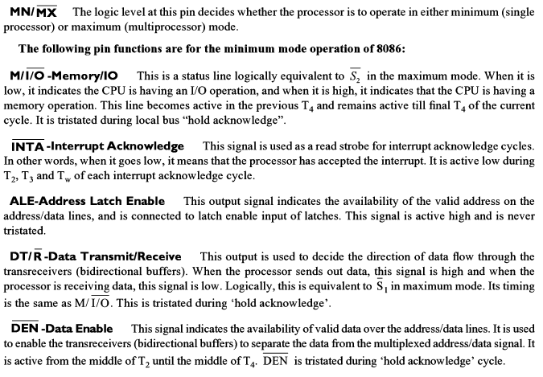
SIGNAL DESCRIPTION (CONTD)

Slide 24
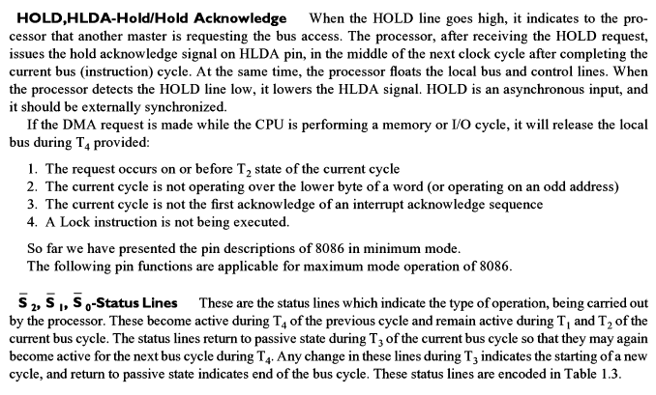
SIGNAL DESCRIPTION (CONTD)

Slide 25
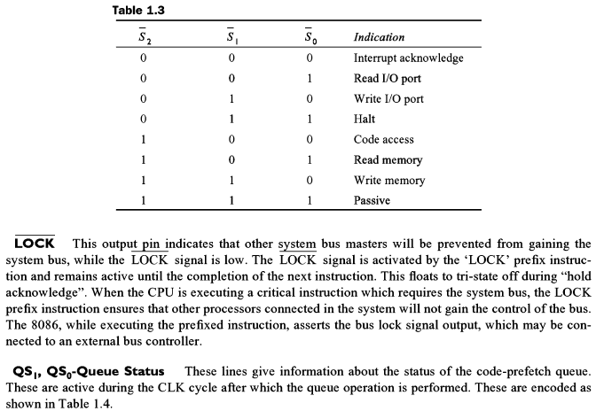
SIGNAL DESCRIPTION (CONTD)

Slide 26
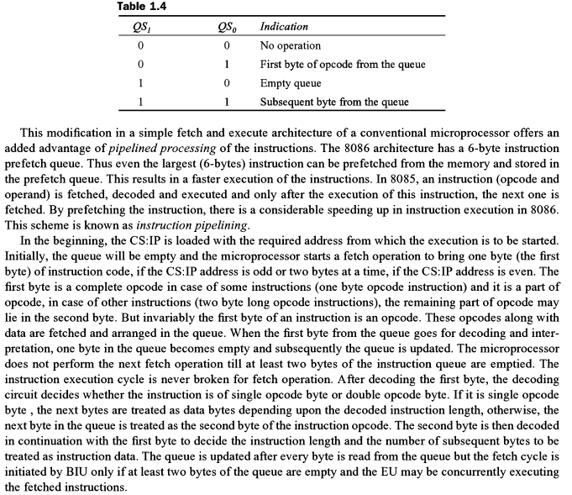

Slide 27
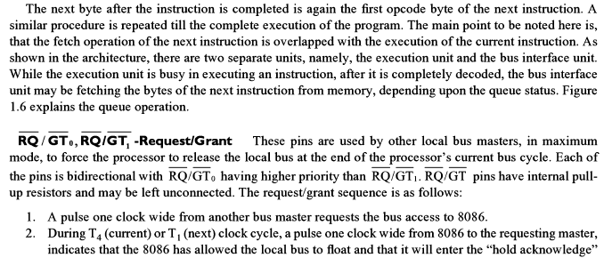

SIGNAL DESCRIPTION (CONTD)

Slide 28
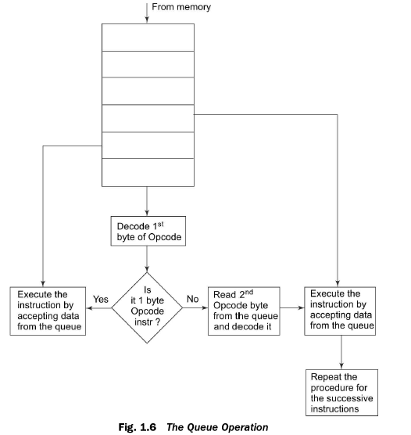

Slide 29
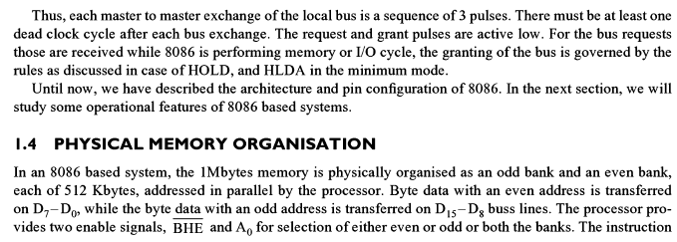
Physical memory organisation

Slide 30
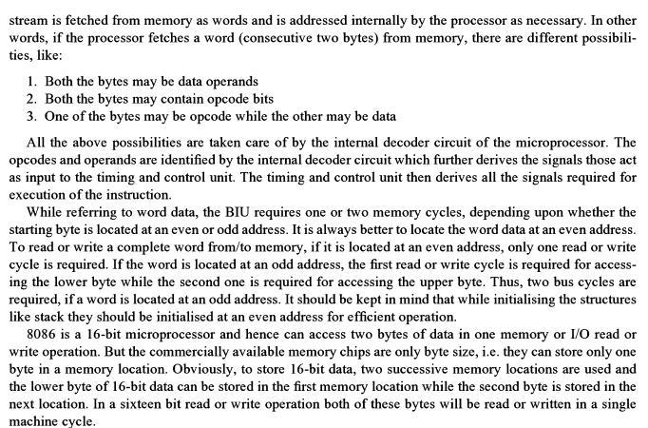
Physical memory organization (contd)

Slide 31
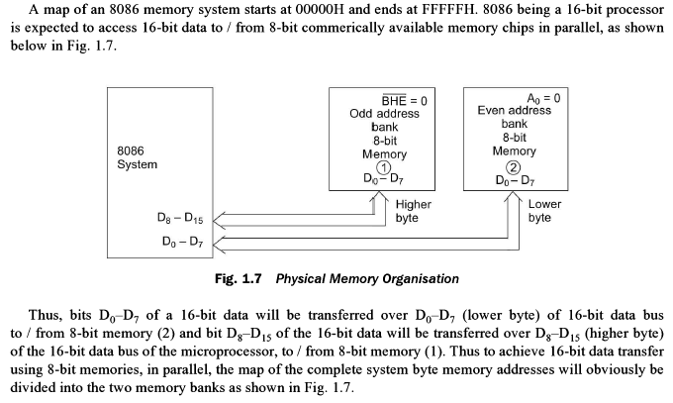
Physical memory organization (contd)

Slide 32
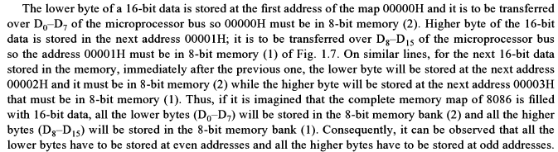
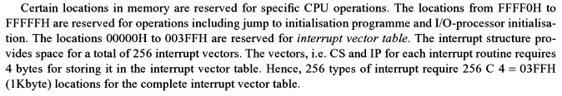
Physical memory organization (contd)

Slide 33
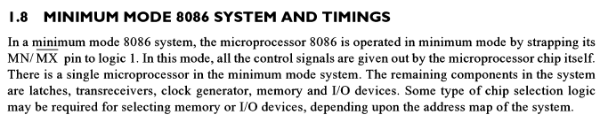
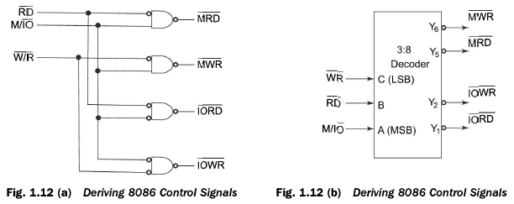
Minimum mode of operation

Slide 34
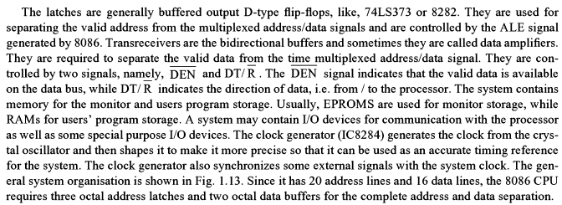
Minimum mode of operation (contd)

Slide 35
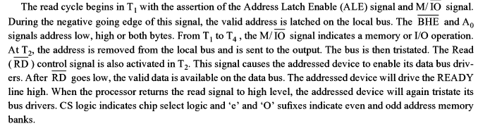

Minimum mode of operation (contd)

Slide 36
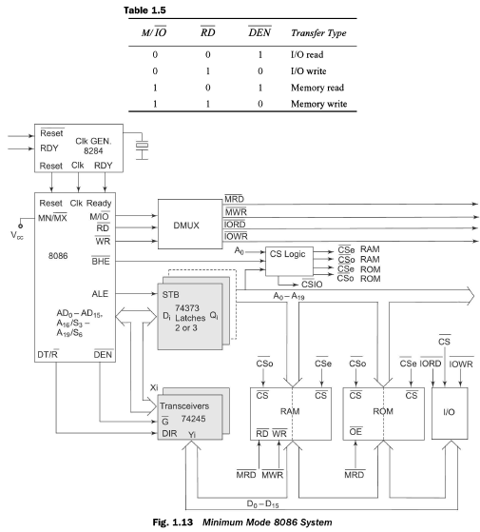

Slide 37
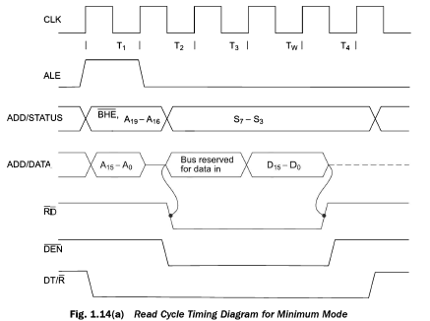
Read cycle timing diagram for minimum mode

Slide 38
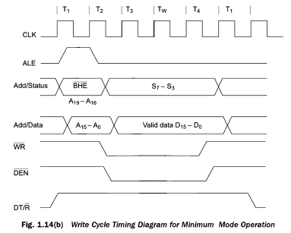
Write cycle timing diagram for minimum mode

Slide 39
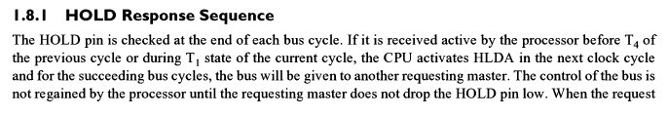

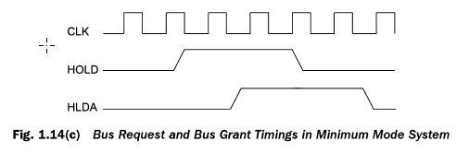
Hold response sequence

Slide 40
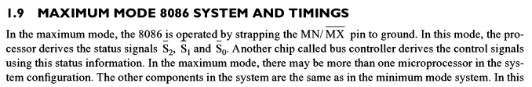
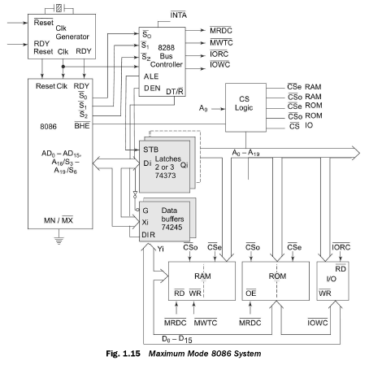

Slide 41
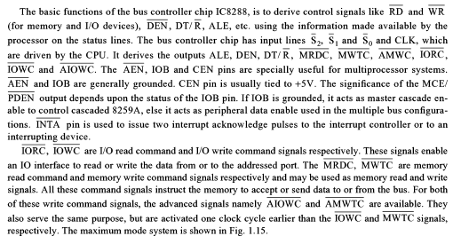
Maximum mode of operation

Slide 42
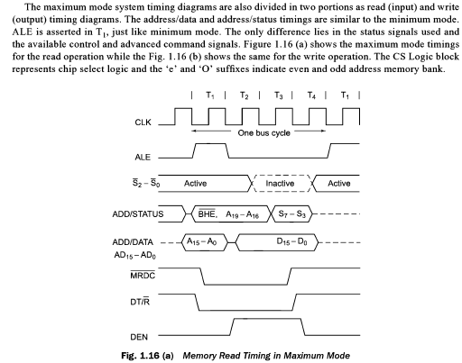

Slide 43
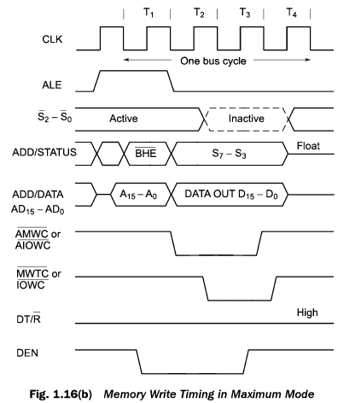

Slide 44
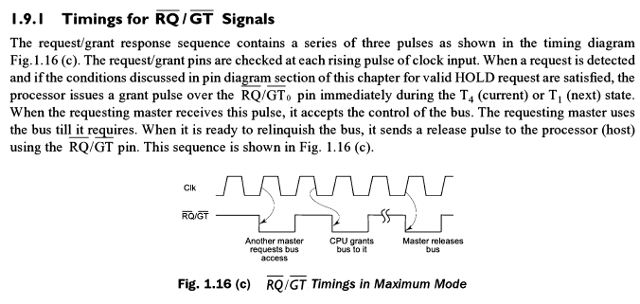
Maximum mode of operation (contd)

Slide 45
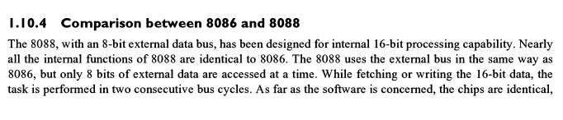
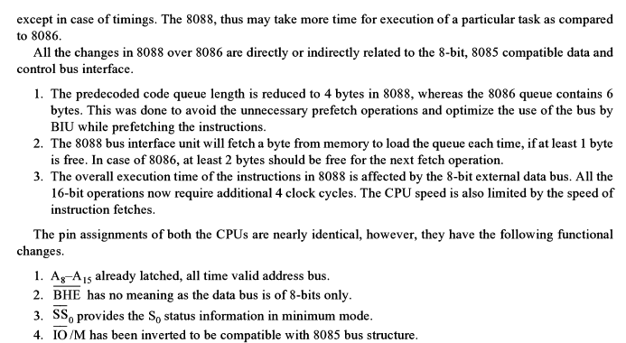

Slide 46
END OF MODULE 1

